Slide 1
LIMITS OF DEEP LEARNING: SEQUENCE MODELING THROUGH THE LENS OF COMPLEXITY THEORY
Sravani Neelapala
Dimitriye Danilovic
Aditya Chawla

Slide 2
COMPLEX REASONING & FUNCTION COMPOSITION
What is ?
Complex reasoning: Solving a problems step by step, requiring multiple layers of thought.
Example: Planning a trip includes: Check weather → Find best route → Calculate costs → Book hotel.
Function Composition: Applying one function to the output of another.
Example: f(g(x) = ?
g(x)=x+2.
f(x)=2x.
f(g(3))=2(3+2)=10.

Slide 3
INTRODUCTION
Deep learning has revolutionized numerous fields in Natural language processing, computer vision, scientific computing and autonomous systems.
Large Language Models(LLMs) capable of solving novel and complex tasks.
Mastery of function composition is the objective, as tasks like mathematical problem-solving , learning discrete algorithms , logical reasoning , and dynamic programming are deeply compositional.
When considering the advanced LLM model GPT-4 achieving 27% accuracy when on basic task like 4-by-3 multiplication.
SSM (Structured state space models) were introduced as an alternative to transformers for handling problems that are naturally sequential and require state tracking.
For the same 4-by-3-digit multiplication task, an SSM-Attention hybrid model, achieves only 17% accuracy.

Slide 4
THEOREMS ON SSM
Complexity theory reveals that transformers come under weak complexity class TC^0.
In this paper; We provide a theoretical framework using complexity theory to explain the limitations of SSMs in sequence modeling.
Theorem 1: one-layer SSM cannot solve function composition.
Theorem 2: Related to Chain of Thought prompting.
Theorem 3 & 4: Limits of what SSM can handle using multi-layer approach.

Slide 5
RELATED WORK
Research has highlighted architectural and training limitations that prevent these models from maintaining accuracy over multiple reasoning steps, leading to issues like hallucinations and reasoning errors.
These findings, demonstrating that CoT prompting does not overcome the fundamental computational limitations.
SSM comes fit within computational complexity classes (specifically the class L)
These approaches aim to combine the strengths of neural networks with symbolic computation to overcome the shortcomings in tasks requiring complex, multi-step reasoning.

Slide 6
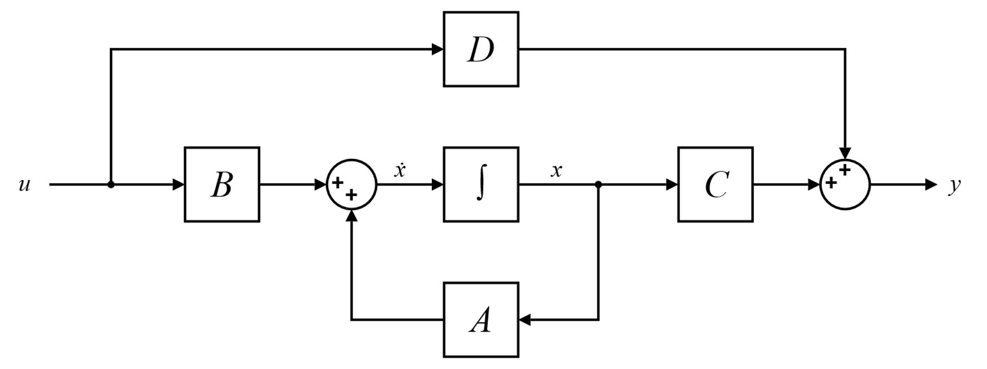
STRUCTURED STATE SPACE MODEL(SSM)
x′(t)=Ax(t)+Bu(t)
y(t)=Cx(t)+Du(t), where
x(t): Hidden state representation
u(t): Input sequence
y(t): Output sequence
A,B,C,D: Learnable system matrices

Slide 7
Theorem 1
Function composition problem:
the zeroth part describes the argument x ∈ A, e.g. ‘Frédéric Chopin’,
the first part describes the function g through |A| sentences in simple, unambiguous language separated by punctuation, e.g., ’the father of Frédéric Chopin is Nicolas Chopin’,
the second part consists of |B| sentences describing the function f , e.g., ’the birthday of Nicolas Chopin is April 15, 1771’,
4. the third part is the query question asking for the value of f (g(x)), e.g. ‘what is the birthday of Frédéric Chopin’s father?’
Consider a function composition problem with input domain size |A| = |B| = n and an SSM layer ℒ with embedding dimension d and computation precision p.
Let R = n log n−(d²+d)p ≥ 0, then the probability that L answers the query incorrectly is at least R/(3n log n) if f is sampled uniformly at random from C^{B}.

Slide 8
Theorem 2
Consider an iterated composition problem with domain size n, computation precision p, and embedding dimension d. An SSM layer requires Ω( √(n log n) / dp ) CoT steps for answering correctly iterated function composition prompts

Slide 9
Theorem 3
The problems of Derivability and 2-SAT cannot be solved by log-precision linear or S6-SSMs provided L ≠ NL. For Mod 2 SAT, the result is valid provided the weaker statement L ≠ Mod 2 L holds. For Horn SAT and Circuit Evaluation, the result holds unless the stronger statement L = P holds.
Corollary: SSMs cannot solve problems beyond complexity-class L.

Slide 10
Theorem 4
The language of a finite-precision SSM is within the class of regular languages.

Slide 11
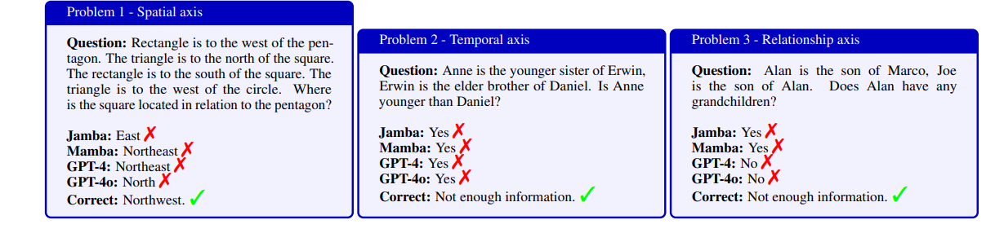
Composition Tasks - Qualitative Analysis
Qualitative example of zero-shot inference on prominent SSM and Attention-based models. None of the models successfully resolved the problems across any of the composition axes.

Slide 12
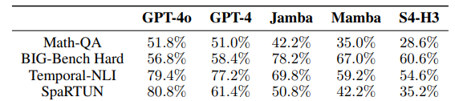
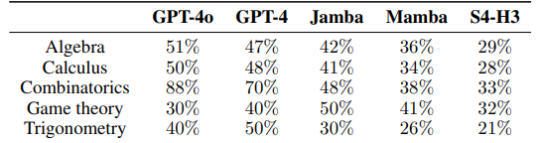
Composition Tasks - Quantitative Analysis
Performance of Attention, SSM and Attention-SSM based models on various function composition tasks involving logical expressions, temporal reasoning, spatial reasoning, and math tasks.
Performance of models on various topics within the MathQA dataset. Input dependency consistentlyimproves performance, with Mamba consistently outperforming S4-H3.

Slide 13
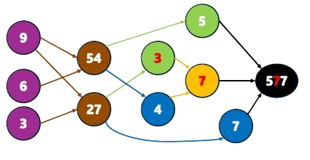
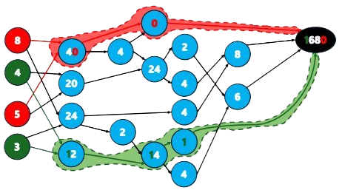
Complex Compositional Tasks - Multi-digit Multiplication
Error Propagation. Carry operation outputs number 3 instead of 2 from node ’27’, and that error is further propagated, yielding incorrect solution in the middle digit, although all other steps were done right.
SSMs and Transformers learn shortcuts that seem to solve function composition but fail with larger inputs and out-of-distribution data.

Slide 14
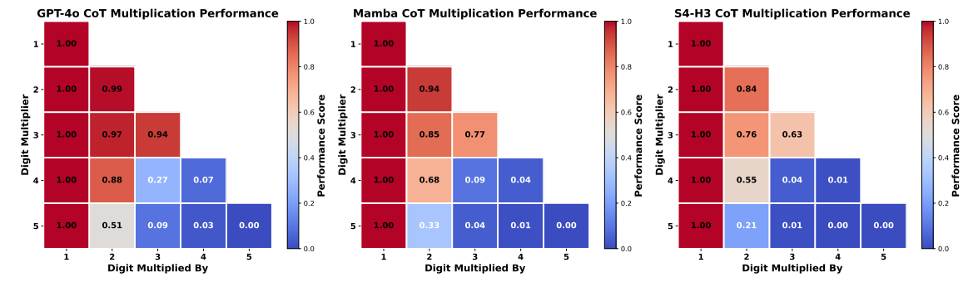
Complex Compositional Tasks - Multi-digit Multiplication Quantitative Analysis
Comparison of different models on multiplication task using CoT.

Slide 15
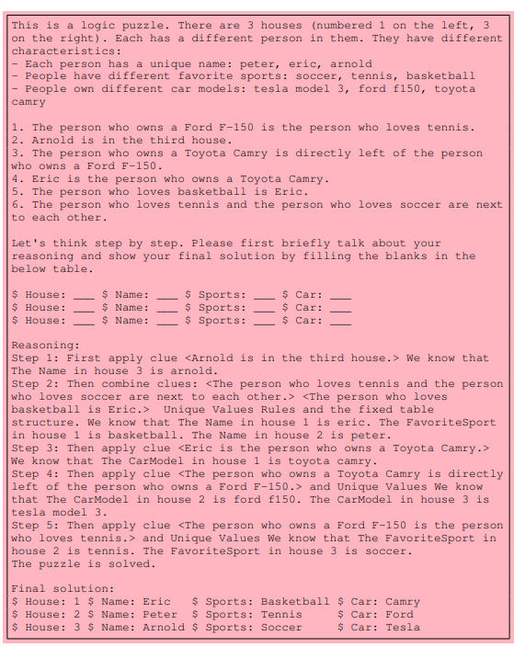
Complex Compositional Tasks - Einstein’s Puzzle
A sample scratchpad for the Einstein’s puzzle task.

Slide 16
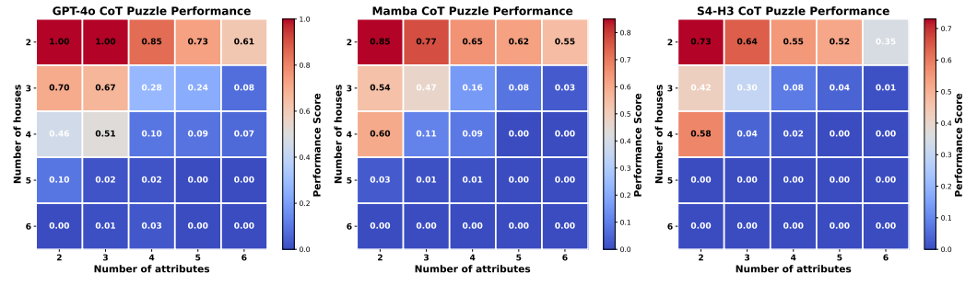
Complex Compositional Tasks - Einstein’s Puzzle Quantitative Analysis
Comparison of different models on puzzle task using CoT.

Slide 17
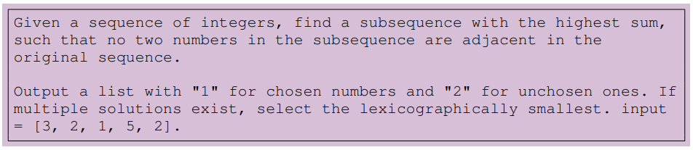
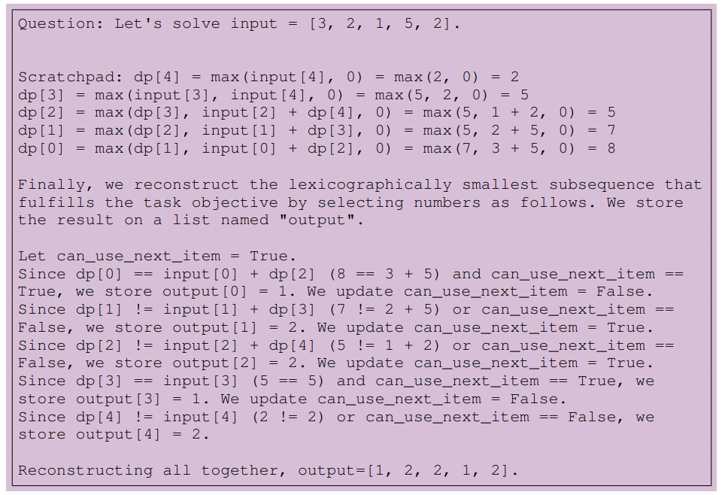
Complex Compositional Tasks - Dynamic Programming
A sample Prompt and scratchpad for the Dynamic Programming task.

Slide 18
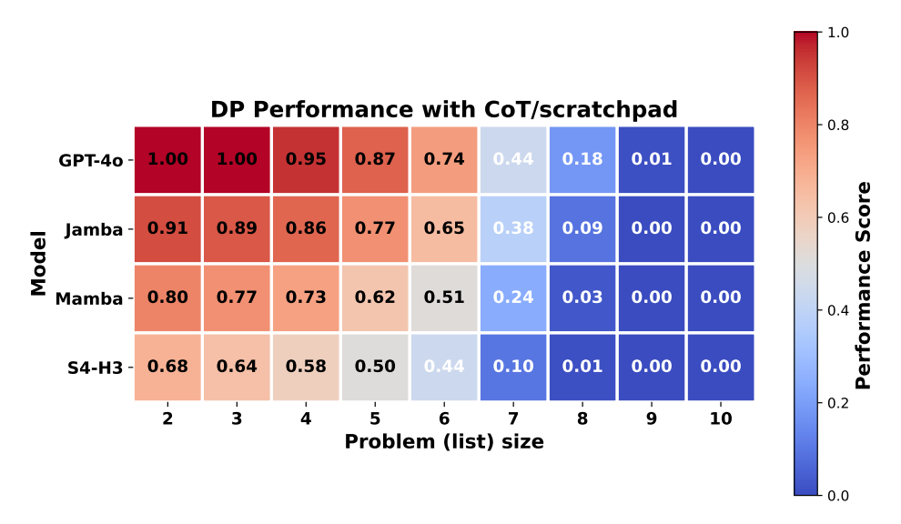
Complex Compositional Tasks - Dynamic Programming Quantitative Analysis
Comparison of different models on Dynamic Programming using CoT.

Slide 19
Conclusion
Structured State Space Models (SSMs) and Transformers face fundamental limitations in performing function composition and complex reasoning tasks.
Significant performance degradation as task complexity increases, even when employing advanced prompting techniques.
Deep Learning based models often resort to shortcuts, leading to errors in multi-step reasoning processes due to their architectural constraints..
Addressing these challenges is crucial for advancing toward general artificial intelligence capable of sophisticated reasoning and problem-solving across diverse domains.

Slide 20
References
N. Zubić, F. Soldá, A. Sulser, and D. Scaramuzza, “Limits of Deep Learning: Sequence Modeling through the Lens of Complexity Theory,” arXiv.org, 2024. https://arxiv.org/abs/2405.16674

Slide 21
Thank you
Please feel free to ask questions.

